Slide 1
Practical Exercise 1
Write a program to take following inputs from the command line and do the corresponding operations according to the last argument and print success or error message .
Create procedure by name studentProfileManagement for create delete and update.
And this procedure should take 10 arguments and last argument should be “action”.
This procedure should do
if action is=‘update’
then procedure should do update operation.
else if action=‘delete’
then do delete operation using args[0]
else if action=‘insert’
then do insert the data corresponding tables.

Slide 2
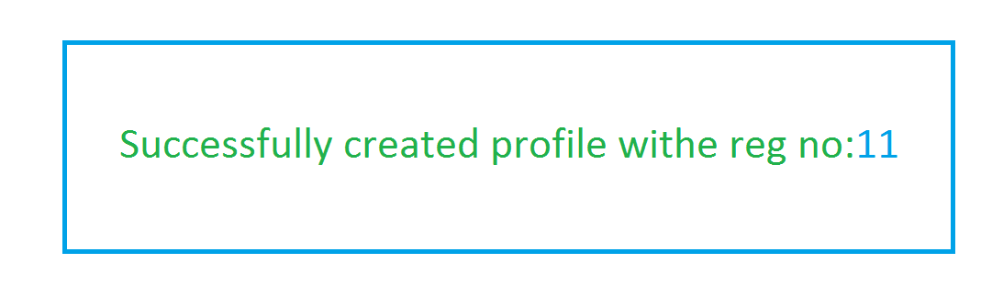
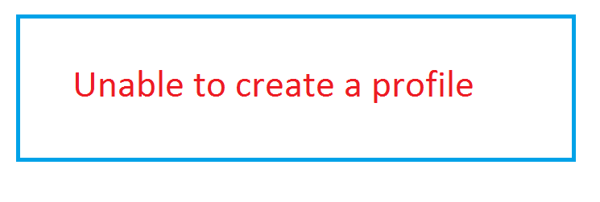
Call studentProfileMgmt(?,?,?,?,?,?,?,?,?,?)
CreateProfile.java
JDBC
Driver
DB
Public static void main(String[] args)
{
BECM3_DB
Students_info
Guardian_info
Students_otherinfo
1. Load the Driver
2. Get the DB Connection via Driver
3. Issue SQL Queries via Connection
call studentProfileMgmt(?,?,?,?,?,?,?,?,?,?)
4. Process the Results
print the success or error message in the browser.
5. Close All JDBC Objects
}

Slide 3
Practical Exercise 2
Write a Java Program which takes the Register Number via command line argument and
1. Check the regno in all 3 tables in the database
2. If regno is present, fetch the data from the
tables(combination of data present in
- students_info,
- guardian_info and - students_otherinfo)
and print it in the console
3 . If regno is not present, print the error message in
the console

Slide 4
Reg.No args[0]
Reg No is not found
OR
regno is found
Reg NO is :1
Firstname is :Praveen
Middlename is :A
Lastname is :D
Gfirstname is :NA
Gmiddlename is:D
Glastname is :A
Isadmin :Y }
StudentSearch.java
JDBC
Driver
DB
Public static void main(String[] args)
{
BECM67&_DB
Students_info
Guardian_info
Students_otherinfo
1. Load the Driver
2. Get the DB Connection via Driver
3. Issue SQL Queries via Connection
Select * from students_info si,guardian_info gi, students_otherinfo soi
where si.regno=gi.regno and gi.regno=soi.regno and soi.regno=?
4. Process the Results
print the success or error message in the console.
5. Close All JDBC Objects

Slide 5
Practical Exercise 3
Write a program which takes the following arguments from the command line in the same order.
1. regno 2 . old password 3. new password
This program should check whether the RegNo and password is correct in the database.
if Yes, then update the current password with new password,
if No then print the error message in the console.

Slide 6
Regno args[1]
Old Password args[2]
New Password args[0]
Unable to change the
Password!!!
Successfully changed
The password..
}
ChangePassword.java
JDBC
Driver
DB
Public static void main(String[] args)
{
BECM67_DB
Students_info
Guardian_info
Students_otherinfo
1. Load the Driver
2. Get the DB Connection via Driver
3. Issue SQL Queries via Connection
Update students_otherinfo set password=? Where regno=? and password=?
4. Process the Results
print the success or error message in the console.
5. Close All JDBC Objects

Slide 7
Practical exercise 4
Write a program to print all data(student_info, guardian_info and students_otherinfo) in the console.

Slide 8
Unable to print the
information
Regno 1
Firstname:Praveen
Middlename: D
Lastname : N
Gfirstname:A
Gmiddlename:D
Glastname: N
Isadmin:Y
----------------------------
Regno 2
firstname Sharuk
Middlename: D
Lastname : N
Gfirstname:A
Gmiddlename:D
Glastname: N
Isadmin:N
-------------------------------
|
|
|
ViewAllStudents.java
JDBC
Driver
DB
Public static void main(String[] args)
{
BECM3_DB
Students_info
Guardian_info
Students_otherinfo
1. Load the Driver
2. Get the DB Connection via Driver
3. Issue SQL Queries via Connection
Select * from students_info si,guardian_info gi, students_otherinfo soi where si.regno=gi.regno and gi.regno=soi.regno
4. Process the Results
print the success or error message in the browser.
5. Close All JDBC Objects
}

Slide 9
Practical Exercise 5
Write a program which takes the following arguments from the command line in the same order.
1. regno 2 .password
This program should check whether the RegNo and password is correct in the database.
if Yes, then print the “login successfull” message along with all data of that regno.
if No then print the error message in the console.

Slide 10
Regno args[0]
Password args[1]
Successful login
Invalid regno /
Password provided
}
LoginJDBC.java
JDBC
Driver
DB
Public static void main(String[] args)
{
BECM3_DB
Students_info
Guardian_info
Students_otherinfo
1. Load the Driver
2. Get the DB Connection via Driver
3. Issue SQL Queries via Connection
Select * from student_info si,guardian_info gi.students_otherinfo soi where si.regno =gi.regno and gi.regno=soi.regno and soi.regno=?and soi.password=?
4. Process the Results
print the success or error message in the browser.
5. Close All JDBC Objects

Slide 11
Practical Exercise 6
Write a program which takes the one input argument from the command line ie regno
This program should check whether the RegNo is correct in the database.
if Yes, then delete the corresponding records from the table.
if No then print the error message in the console.

Slide 12
Regno args[0]
Successful deleted
the regno :12
Invalid regno
provided
DeleteJDBC.java
JDBC
Driver
DB
Public static void main(String[] args)
{
BECM3_DB
Students_info
Guardian_info
Students_otherinfo
1. Load the Driver
2. Get the DB Connection via Driver
3. Issue SQL Queries via Connection
Call deleteStudent(?);
4. Process the Results
print the success or error message in the browser.
5. Close All JDBC Objects
}

Slide 13
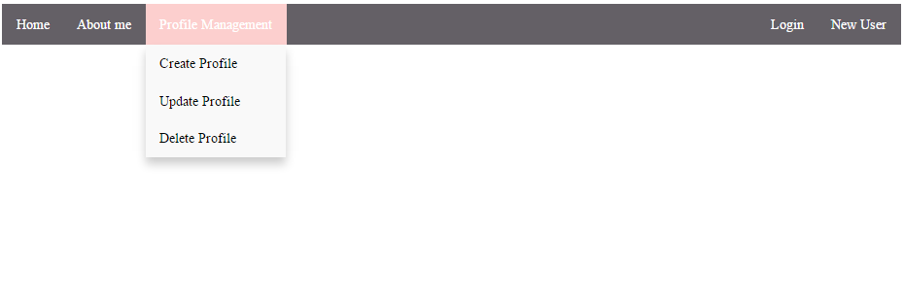
Create header as show bellow

